Slide 1
Lightning Web Component
Amit Singh

Slide 2
Introduction
Introduction to LWC
Why LWC ( LWC vs AURA )
Software Installation
Useful Plugins for VS Code
Your First Web Component

Slide 3
Anatomy of LWC
LWC is a programming model (stacks) that is used to develop the lightning component like Aura.
Lightning web components are custom HTML elements built using HTML and modern JavaScript
It’s a UI framework that is built using native HTML and modern JavaScript.
It uses core web component standards and leverages custom elements, templates, decorators, modules, shadow DOM

Slide 4
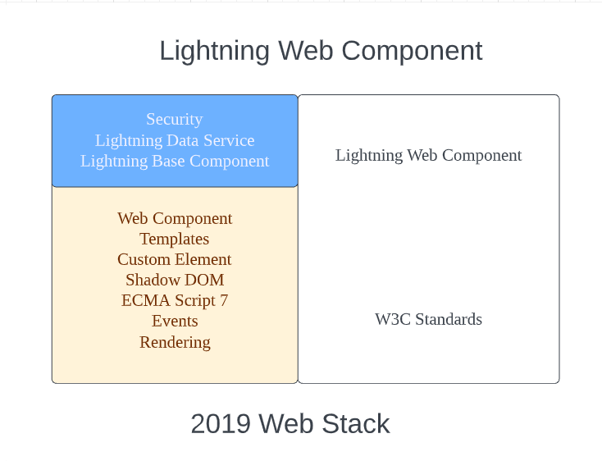
Anatomy of LWC

Slide 5
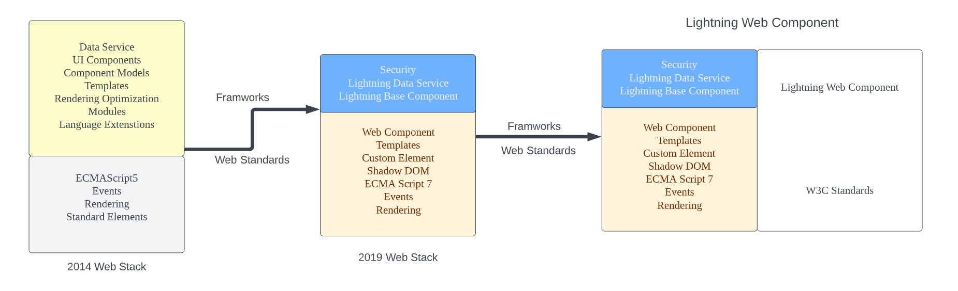
LWC vs Aura
At the same time, many different frameworks came into the picture like Angular, React, and Aura. All these frameworks came with these missing key elements that we needed to create UI components. Like
Shadow DOM
Custom Templates
Custom Elements

Slide 6
LWC is Preferred because?
ECMAScript
ES6 (ECMAScript 2015)
ES7 (ECMAScript 2016)
ES8 (ECMAScript 2017)—excluding Shared Memory and Atomics
ES9 (ECMAScript 2018)—including only Object Spread Properties (not Object Rest Properties)
Classes
Modules
Promises
Decorators
Web Components
Custom Elements
Shadow DOM
Templates and slots

Slide 7
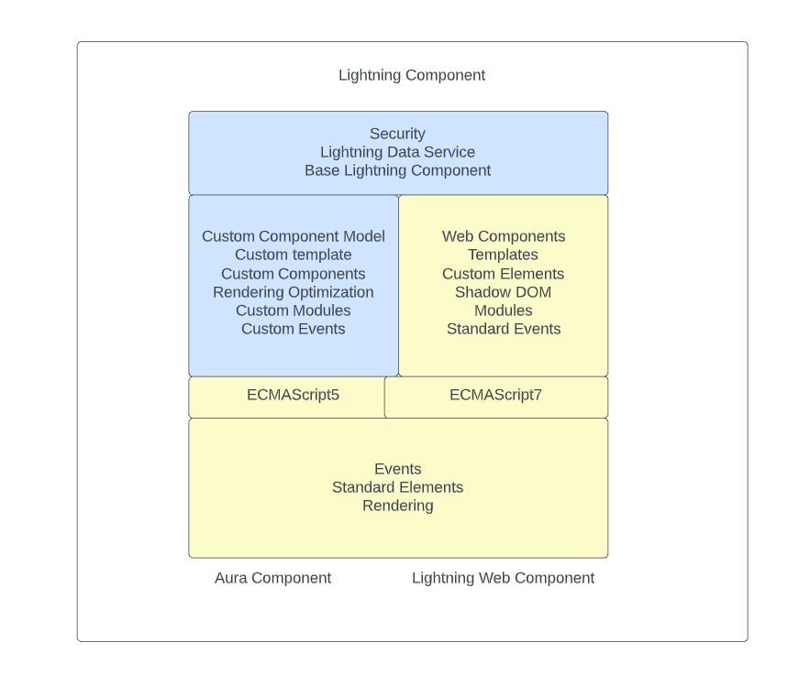

Slide 8
Benefits
With the power of the latest web stack, LWC comes with many different advantages over aura components as follows:
Better performance
Modern web standards
Compatible with Aura components
Faster loading sites
Better security, better testing, and better browser compatibility
Ease of development

Slide 9
Software Setup
VS Code
JDK Installation (Zulu)
Salesforce CLI
Salesforce Extension Pack
Important extensions like beautifier, bracket colorizer, etc, LWC Short Keys, LWC Builder

Slide 10
First Lightning Web Component
The component name should follow below naming convention rules:
Must begin with a lowercase letter
Must contain only alphanumeric or underscore characters
Must be unique in the namespace
Can’t include whitespace
Can’t end with an underscore
Can’t contain two consecutive underscores
Can’t contain a hyphen (dash)

Slide 11
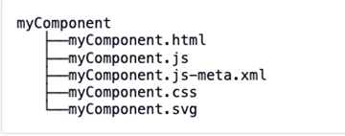
Component Structure

Slide 12
Questions
What are the benefits of the LWC?
Can we use Aura inside LWC?
Can we use LWC Inside AURA?
What is the Top-Most element in LWC?
What are the default files in LWC?
Can we create extra .js file inside LWC component?
Can we create extra .html file inside LWC Component?

Slide 13
Day 2 - Agenda
Decorators in LWC
Properties in Lightning Web Component
Public Property
Private Property
Public Method
Conditional Rendering
Conditional Rendering with Tom & jerry
Iterate through with List
For each
Iterator
Questions

Slide 14
Decorators in LWC
There are mainly 2 types of decorators in LWC @api & @wire
1 - @api – Used to create the public variables/property & public method inside JavaScript class for LWC
2 - @wire – Used to call the Apex Class Methods, Call the modules/methods provided by Lighting Data Service & UI Record API

Slide 15
Properties in Lightning Web Component
In LWC like, like other programming model then are 2 types of properties
Private
Public
You can also create public/private methods inside JavaScript class for LWC

Slide 16
Conditional Rendering
Displaying the component/tag or portion of a component when needed is very important.
In lwc we can use if:true or if:false directive to show/hide the component dynamically

Slide 17
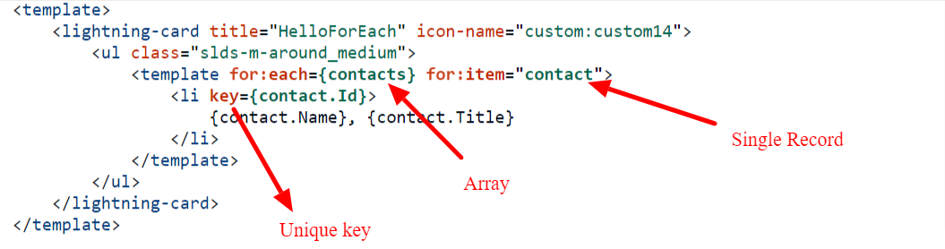
Iterate through with List
For:each When using the for:each directive, use for:item="currentItem" to access the current item. This example doesn’t use it, but to access the current item’s index, use for:index="index". To assign a key to the first element in the nested template, use the key={uniqueId} directive.

Slide 18
Iterate through with List
Iterator
To apply a special behavior to the first or last item in a list, use the iterator directive, iterator:iteratorName={array}. Use the iterator directive on a template tag.
value—The value of the item in the list. Use this property to access the properties of the array. For example, iteratorName.value.propertyName.
index—The index of the item in the list.
first—A boolean value indicating whether this item is the first item in the list.
last—A boolean value indicating whether this item is the last item in the list.

Slide 19
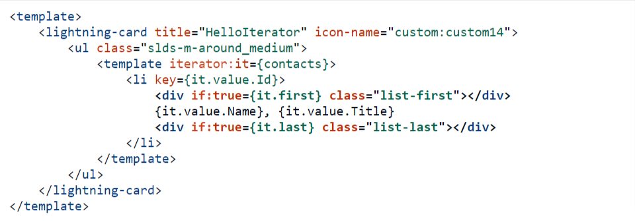
Iterate through with List

Slide 20
Questions
What are the Different Decorators in LWC?
How to create a public method in Lightning Web Component?
What are the different ways to display a list over LWC?
All properties are reactive in LWC?
When should we use Iterator in LWC to render the list?

Slide 21
Day 3 - Agenda
Slots in LWC
Call Client-Side JavaScript From a Button
Call Client-Side JavaScript on Browser Events
Getter Setter in LWC
Component Composition

Slide 22
Slots in LWC
Slot tag is simply a placeholder on the component where a parent component can pass the HTML content i.e. markup.
There are two types of slots:
Unnamed slots - These slots are placeholders on child components that don't have any name associated with them, i.e. if the child has multiple slot tags and parent passes some markup all slots will receive the same markup as there is no identifier to define which markup should go where.
Named slots - When you are passing markup from a parent you define which slot you want to send this markup to by using the slot name.
<slot></slot>
<slot name=“order”></slot>

Slide 23
Call JavaScript Class method
Call Client-Side JavaScript From a Button
Call Client-Side JavaScript on Browser Events
handleChange(event){
}
handleClick(event){
}
handleChange = (event)=> {}

Slide 24
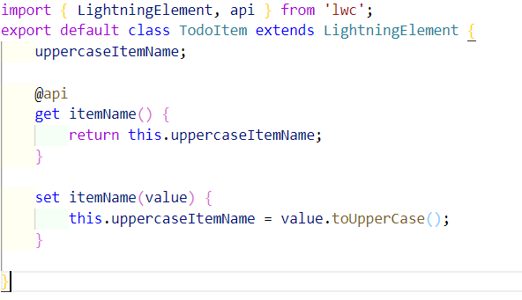
Getter Setter in LWC
To execute a logic every time when a value of a property changes use custom setter method.

Slide 25
Component Composition
Component composition is to create a component hierarchy. For example – Parent/Child/Grand Child
Example – You wanted to display the list of Account Records so you can use a child component to display the account details and use parent component to display the account list

Slide 26
Questions
Can we use setter method without parameter inside it?
What are slots in LWC?
How many level of component composition we can create in LWC?

Slide 27
Day 4 - Agenda
Shadow DOM
Events in Lightning Web Component
Call Parent Method from Child Component
Bubble Event
Composed Event
Call Child Method From parent Component

Slide 28
Shadow DOM
The Shadow DOM have three primary effects: DOM access, CSS isolation, and event propagation. LWC components are "first-class" DOM elements.
Events – Events can not cross the Shadow Root by default.
CSS - CSS cannot affect parent, child, or sibling CSS. It is completely isolated, which allows a component to appear as the developer intended regardless of what anyone else might do to that component.
DOM - This should be of no surprise, but you can't use things like document.querySelector to find elements outside of your own Shadow DOM.

Slide 29
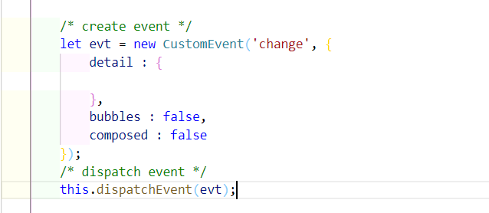
Events
Events in LWC are used to communicate between 2 or more components where child component will fire the event and parent component will handle the event.
Events in Lightning web components are built on DOM Events, a collection of APIs and objects available in every browser.
To create the event in LWC we use CustomEvent interface

Slide 30
Events
Event name best practices:
No uppercase letters
No spaces
Use underscores to separate words
Don’t prefix your event name with the string on, because inline event handler names must start with the string on
Note: - If you pass an object in event detail then any handler can change it without notifying to child component which is bad.

Slide 31
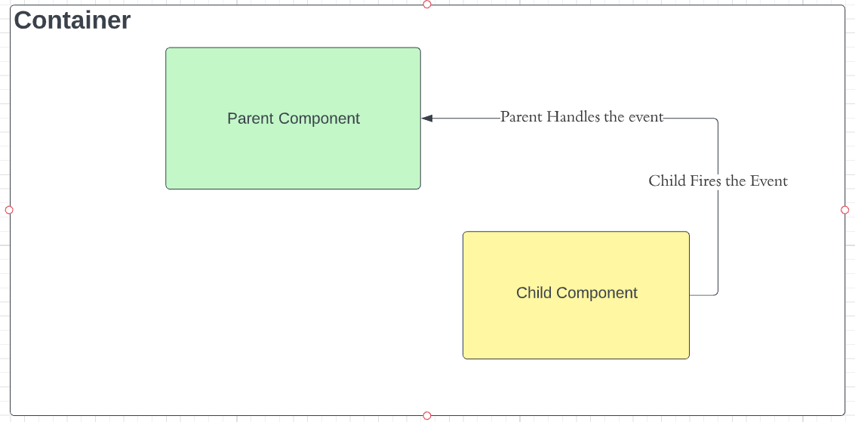

Slide 32
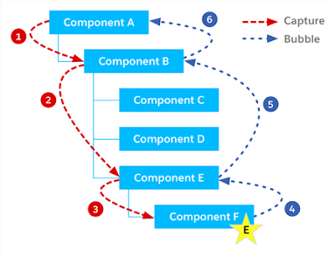
Event Propagation

Slide 33
Event Propagation
Event Propagation:
When an event is fired the event is propagated up to the DOM. Event propagation typically involves two phases event bubbling and event capturing.
bubbles A Boolean value indicating whether the event bubbles up through the DOM or not. Defaults to false.
composed A Boolean value indicating whether the event can pass through the shadow boundary. Defaults to false.

Slide 34
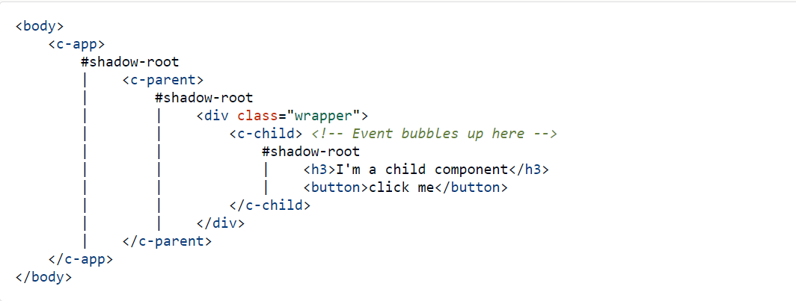
Event Propagation
Let's understand each combination.
Bubbles: false and Composed: false
This is the default configuration in which event is fired, it can be handled only at event listener defined at component as we saw in earlier examples.

Slide 35
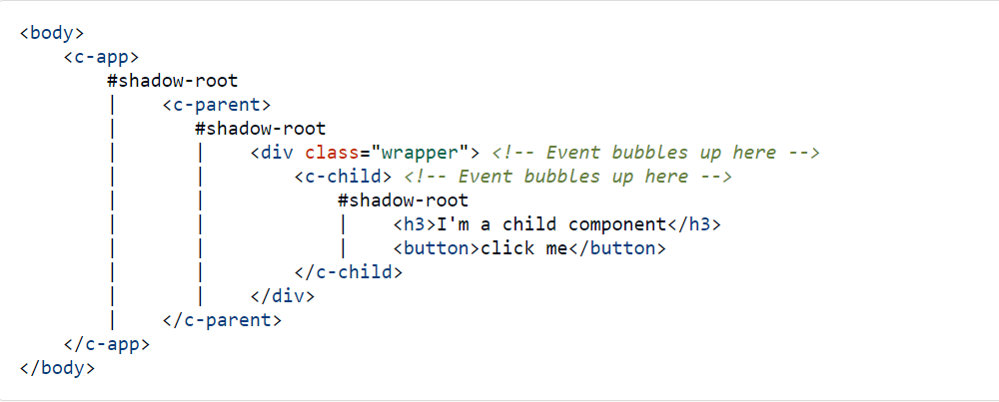
Event Propagation
Bubbles: true and Composed: false
The event bubbles up through the DOM but doesn’t cross the shadow boundary.

Slide 36
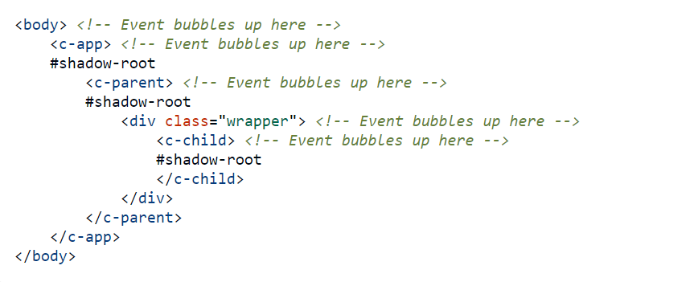
Event Propagation
Bubbles: true and Composed: true
This type of event bubbles up through the DOM and crosses the shadow boundary. This event will bubble up all the way to document root as it can cross shadow boundaries.

Slide 37
Event Propagation
Bubbles: false and Composed: false
This configuration is currently not supported.

Slide 38
Questions
What are the benefits Shadow DOM?
Can we send the event notification from parent to child?
Can we call the child component method from parent component?
What are the different phases of an Event in LWC?
What are the three combination of event phases?
Can we pass object from event as detail property?

Slide 39
Assignment
Use https://gist.github.com/amitastreait/e271ffa3eb5c3f11e6b4a4969d78bf7a JSON and display the list of All Contact Record and Only display Name & Title
Create 1 Lightning Web Component to display the list of Contact Record from the above JSON file
Create another LWC Component which will display the Contact Details
Name
Title
Email
Phone
Picture
Now Create third Component which will have the above 2 component. When user click on Any Contact Record it should fire the event and send back Contact Id.
Find the correct contact record and then Contact Detail Component will display the contact information

Slide 40
Day 5 - Agenda
Lightning Data Service
Record Form, Record View Form, Record Edit Form
UIRecord API
Object Info API

Slide 41
Lightning Data Service
Lightning Data Service manages data for you; changes to a record are reflected in all the technologies built on it. Contrastingly, data from Apex is not managed; you must refresh the data.
In a Lightning web component, perform operations on data and access metadata using these technologies built on Lightning Data Service:
Components—lightning-record-edit-form, lightning-record-form, and lightning-record-view-form
Wire adapters and functions in the lightning/ui*Api modules

Slide 42
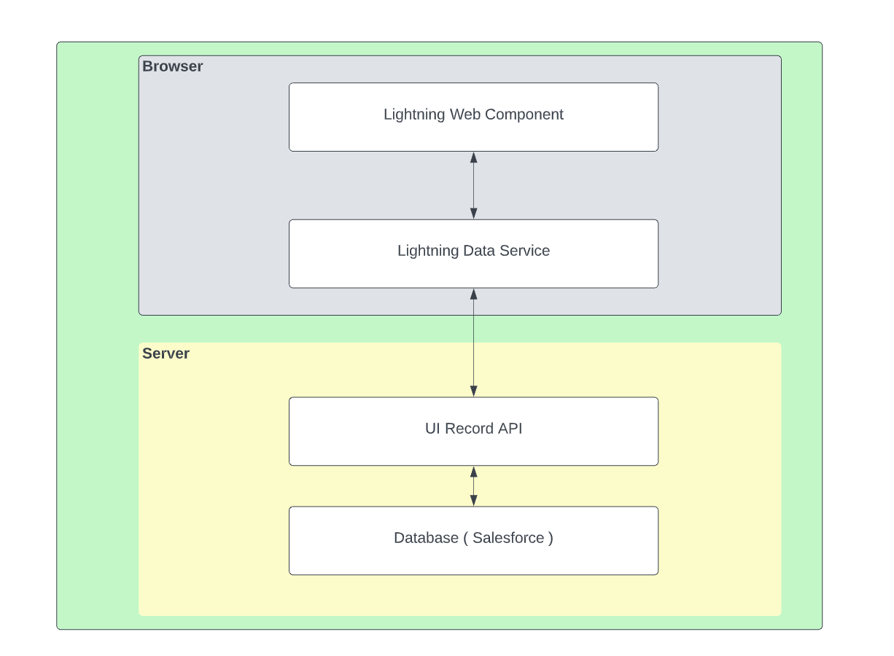
Lightning Data Service

Slide 43
Work with Data using Base Components
lightning-record-edit-form—Displays an editable form.
lightning-record-view-form—Displays a read-only form.
lightning-record-form—Supports edit, view, and read-only modes

Slide 44
UIRecord API
lightning/uiRecordApi module includes wire adapters to record data and get default values to create records. It also includes JavaScript APIs to create, delete, update, and refresh records.
createRecord(recordInput)
deleteRecord(recordId)
getRecord
getFieldValue(record, field)
updateRecord(recordInput, clientOptions)

Slide 45
createRecord(recordInput)
This method creates a record with the provided input for the specific object.
Syntax
import { createRecord } from 'lightning/uiRecordApi';
createRecord(recordInput: Record): Promise<Record>
const fields = {};
fields[NAME_FIELD.fieldApiName] = this.name;
const recordInput = { apiName: ACCOUNT_OBJECT.objectApiName, fields };

Slide 46
updateRecord(recordInput, clientOptions)
Updates a record. Provide the record Id of the record to update in recordInput.
Syntax
import { updateRecord } from 'lightning/uiRecordApi';
updateRecord(recordInput: Record, clientOptions?: Object): Promise<Record>
const fields = {};
fields[ID_FIELD.fieldApiName] = this.contactId;
fields[FIRSTNAME_FIELD.fieldApiName] = ‘’
fields[LASTNAME_FIELD.fieldApiName] = ‘’
clientOptions = {'ifUnmodifiedSince' : lastModifiedDate}

Slide 47
deleteRecord(recordId)
import { deleteRecord } from 'lightning/uiRecordApi';
deleteRecord(recordId: string): Promise<void>

Slide 48
getRecord
import { LightningElement, wire } from 'lwc';
import { getRecord } from 'lightning/uiRecordApi';
@wire(getRecord, { recordId: string, fields: string|string[], optionalFields?: string|string[] })
propertyOrFunction
@wire(getRecord, { recordId: string, layoutTypes: string|string[],
modes?: string|string[], optionalFields?: string|string[] })
propertyOrFunction
getFieldValue(this.account.data, PHONE_FIELD)

Slide 49
Questions
What is Lighting Data Service?
What are benefits if LDS?
Can we use Dynamic Fields in LDS?

Slide 50
Assignment
Create a Lightning Web Component which will create the Account/Contact & Opportunity using the Same Component and Lightning Data Service.
There will be 3 parts in LWC like below
Account
Contact
Opportunity
After clicking on Save button it should create Account first, Then Contact under that Account and then Opportunity under that account

Slide 51
Day 6 - Agenda
Call Apex using @wire
Call Wire method using button click
Error handling in @wire methods
Call Apex using the imperative method

Slide 52
@wire adaptor in Salesforce
To read Salesforce data, Lightning web components use a reactive wire service.
To use @wire to call an Apex method, annotate the Apex method with @AuraEnabled(cacheable=true)
A client-side Lightning Data Service cache is checked before issuing the network call to invoke the Apex method on the server.
To refresh stale data, call refreshApex(), because Lightning Data Service doesn’t manage data provisioned by Apex.
import apexMethodName from '@salesforce/apex/Namespace.Classname.apexMethodReference';
@wire(apexMethodName, { apexMethodParams })
propertyOrFunction;

Slide 53
Imperative Apex
To control when the method invocation occurs (for example, in response to clicking a button), call the method imperatively. When you call a method imperatively, you receive only a single response
In the following scenarios, you must call an Apex method imperatively as opposed to using @wire.
To call a method that isn’t annotated with cacheable=true, which includes any method that inserts, updates, or deletes data.
To control when the invocation occurs.
To work with objects that aren’t supported by User Interface API, like Task and Event

Slide 54
Questions
What are the requirement to make the apex call from LWC?
What are the minimum requirement to make a @wire call?
Can we call a @wire method with button click?
Can we mutate the data returned by @wire method
Can we perform the DML from the apex method which is called from @wire adaptor?

Slide 55
Assignment
Create a LWC which will call the apex class method using @wire method that will return the list of top 10 accounts and do console.log for the data. Display the list of accounts in LWC.
Create a LWC which will call the apex class method using @wire method but make sure that the method will be called from a button click that will return the list of top 10 accounts and do console.log for the data. Display the list of accounts in LWC.
Create a LWC Component to display the input to create Account Record and have a button. On the Button click call a method, that method should create the account in Salesforce.

Slide 56
Day 7 - Agenda
Use External Library in LWC
Use Custom label in LWC
How to use reusable CSS in LWC

Slide 57
Use External Library in LWC
You can use third-party JavaScript libraries with Lightning web components. For example, use a library with interactive charts and graphs or a library that reduces code complexity.
Download the library from the third-party library's site.
Upload the library to your Salesforce organization as a static resource.
import resourceName from '@salesforce/resourceUrl/resourceName';
import { loadStyle, loadScript } from 'lightning/platformResourceLoader';
import myLib from '@salesforce/resourceUrl/myLib';
Load the library and call its functions in a then() method
loadScript(this, myLib + '/myLib.js').then(() => {
let result = myLib.myFunction(2,2);
});

Slide 58
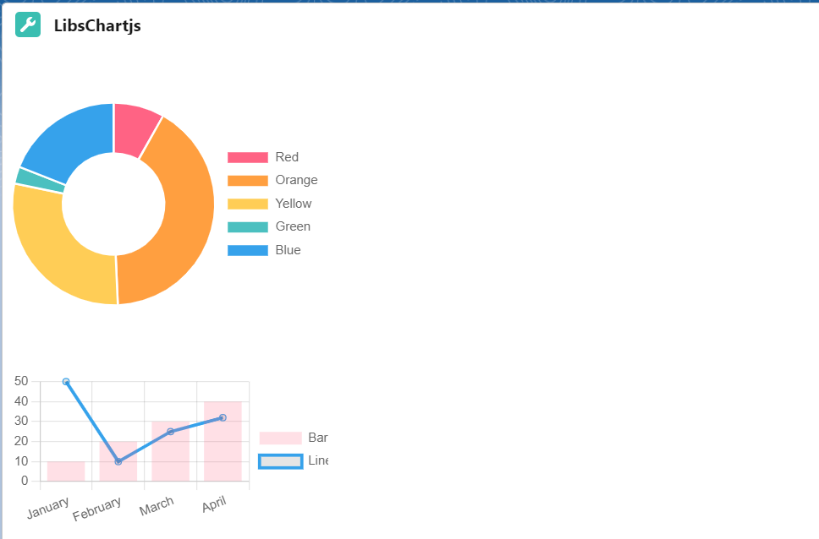
Use External Library in LWC
https://www.chartjs.org/docs/latest/
Full Calendar v4 - https://fullcalendar.io/docs/v4/getting-started

Slide 59
Use Custom label in LWC
Custom labels are text values stored in Salesforce that can be translated into any language that Salesforce supports.
Use custom labels to create multilingual applications that present information (for example, help text or error messages) in a user’s native language.
import labelName from '@salesforce/label/labelReference';

Slide 60
Share CSS
/* Syntax */
@import 'namespace/moduleName';
/* Example */
@import 'c/cssLibrary';

Slide 61
Assignment
Create Google Calendar to display the Events from Salesforce as well as from Google Calendar as well.
Here is the reference Link for the same - events from Google Calendar
Also, implement the event click for date & event. When User clicks on Date then open a new popup to add the Event for the same date.
If user clicks on the event and the event is of type Salesforce Event Open the Popup to display the event details.

Slide 62
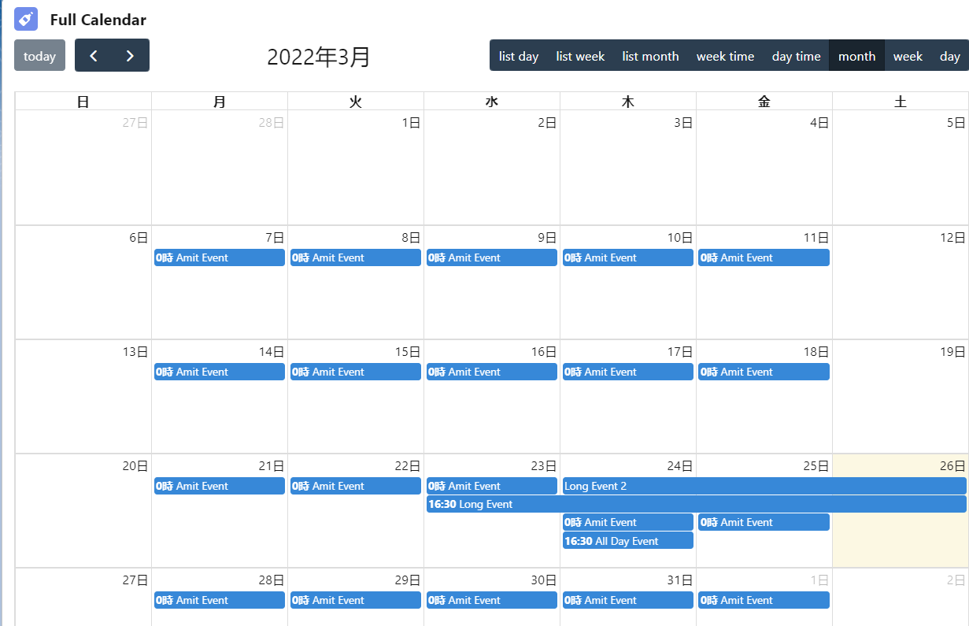
Assignment

Slide 63
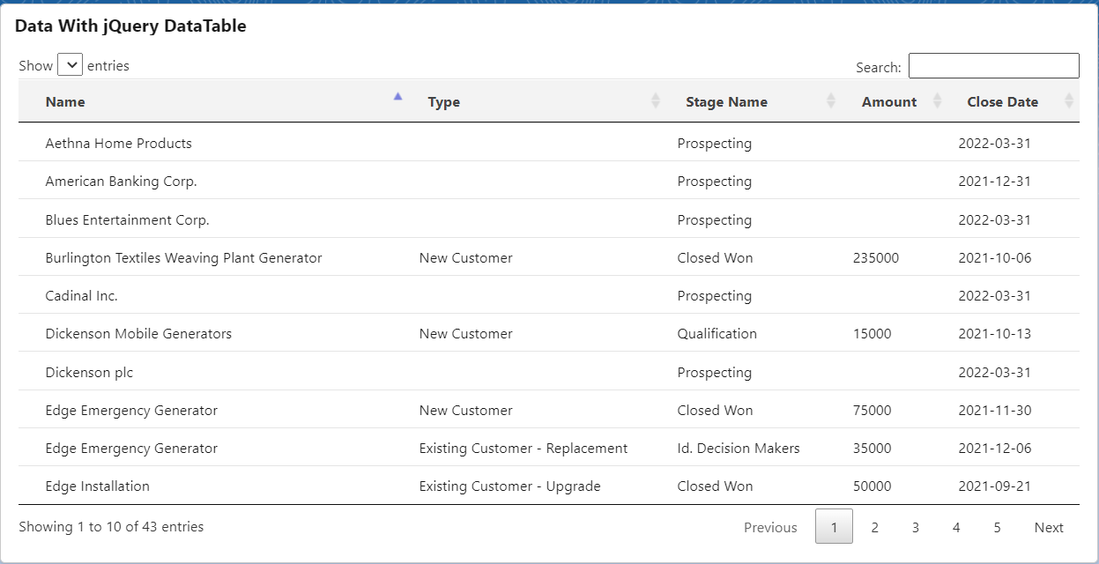
Assignment 2
Create a Lighting Web Component which will display all the opportunities using Jquery DataTable

Slide 64
Day 8 - Agenda
Toast Event in LWC
Page Reference in LWC
Lightning Message Service

Slide 65
Toast Event in LWC
import { ShowToastEvent } from 'lightning/platformShowToastEvent';

Slide 66
Day 9 - Agenda
Configuration File in LWC
Record Page
Home Page
App Page
TAB
Community
Flow
Inbox
Quick Action
Use LWC inside VF Page

Slide 67
Day 10 - Agenda
Lookup Component
Picklist Component

Slide 68
Day 11 - Agenda
Rendrer in LWC
Work with Lighting Data Table in LWC

Slide 69
Day 12 - Agenda
Dynamic Add Delete Row in LWC
Share code using JavaScript

Slide 70
Day 13 - Agenda
Platform Events in LWC

Slide 71
Project

